Slide 1
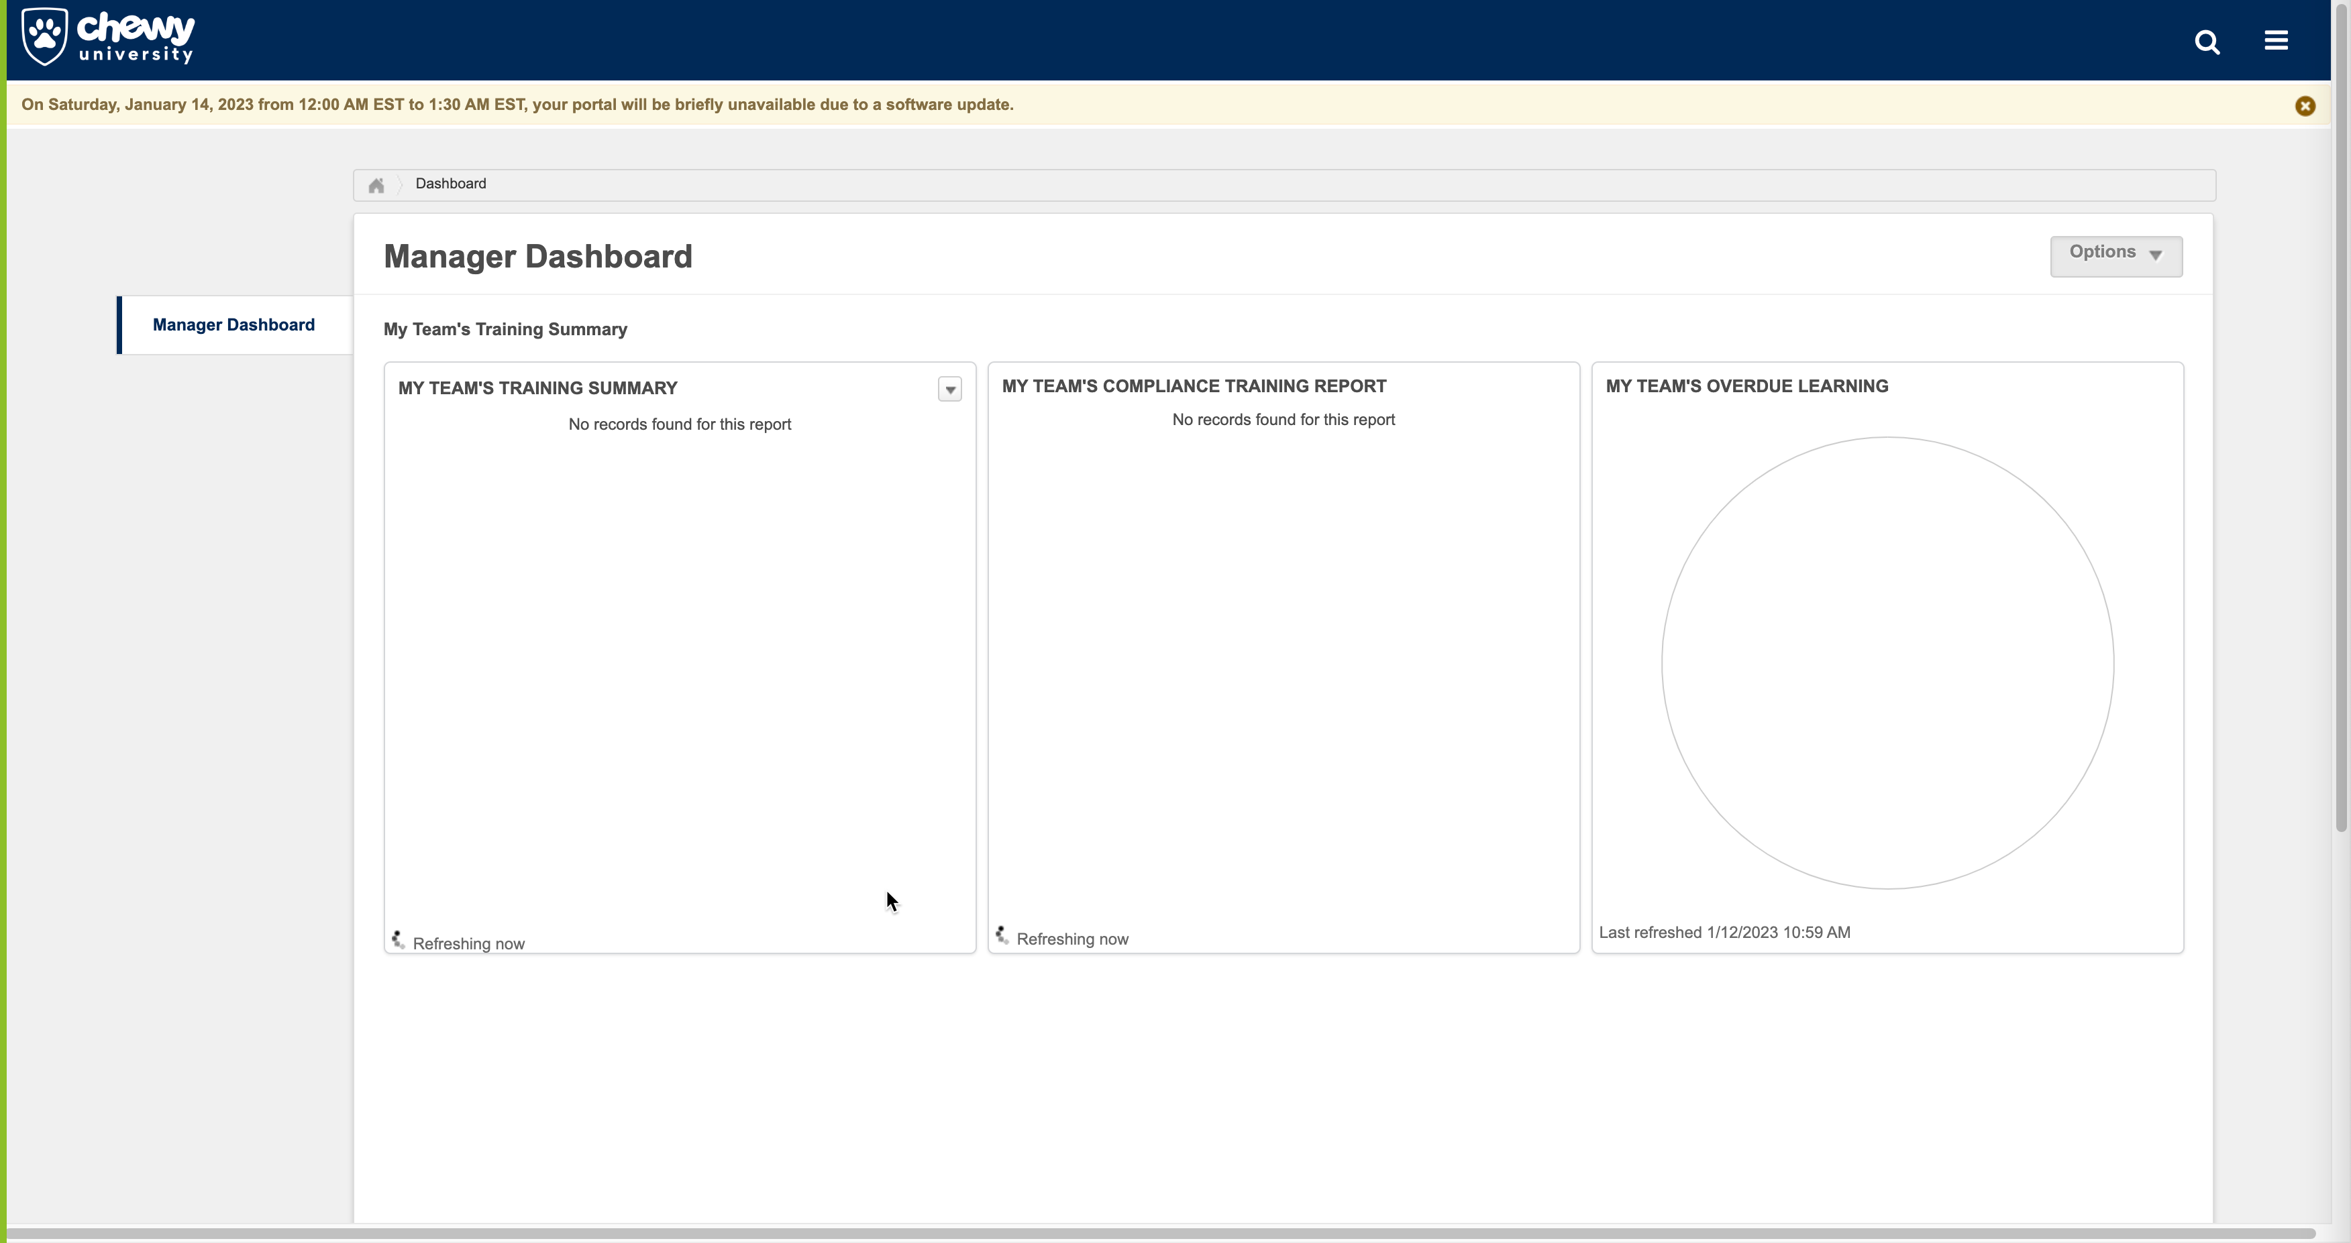
Looks like the Manager Dashboard defaults to blank, and isn’t updated past August or something (I wish I noticed before I hit “Refresh”), but it looks like users have to specifically refresh to get an update, might be worth mentioning….apologies if you already have, and I just missed it!

Slide 2
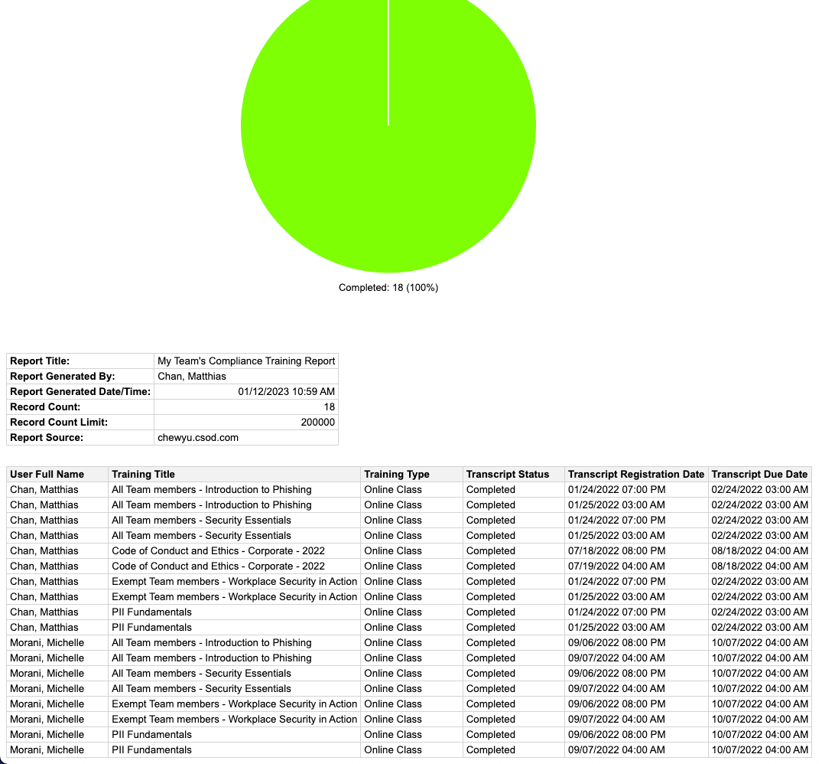
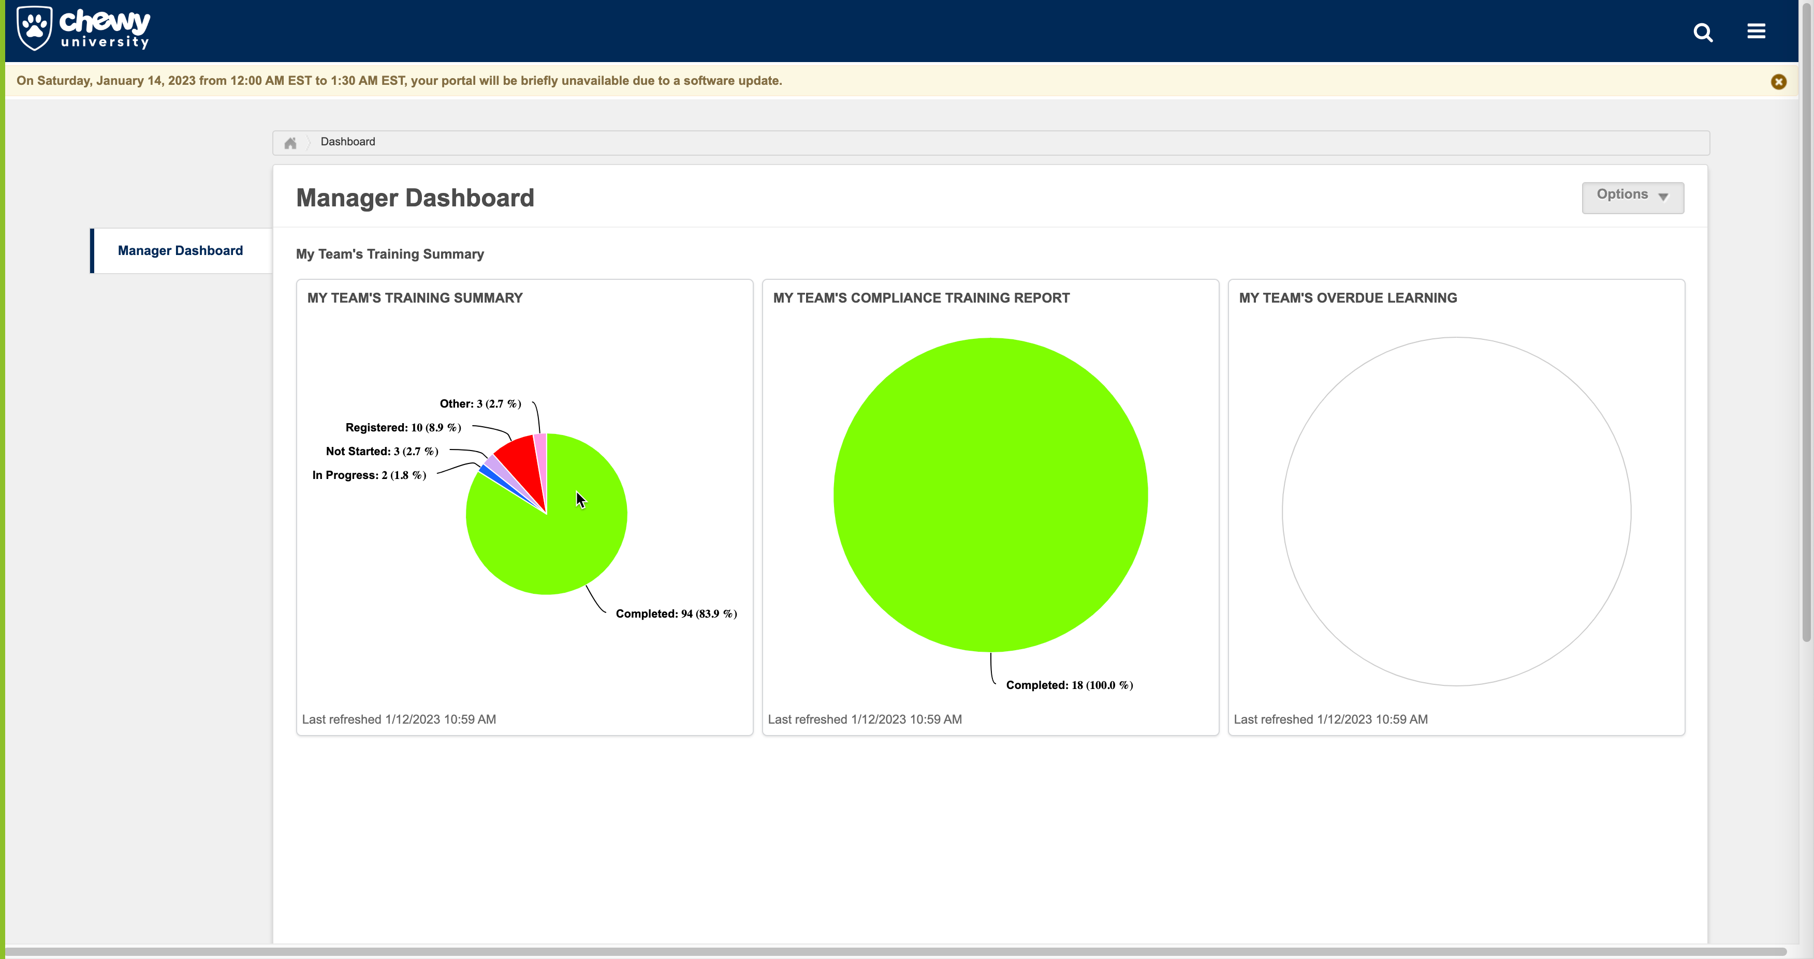
I thought the counts seemed a little high, and didn’t really match what as in the transcript I saw for my DRs, so dug into the details. It looks like we may have duplicated or double loaded some data? See below, but each record looks like it’s in there twice…

Slide 3
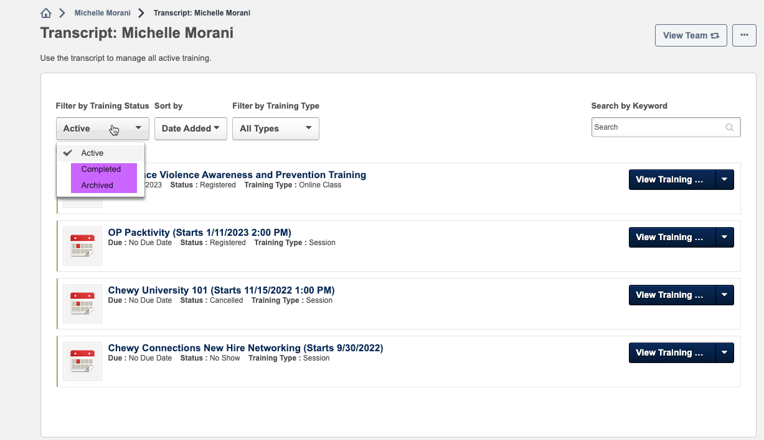
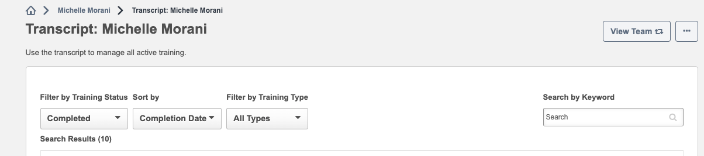
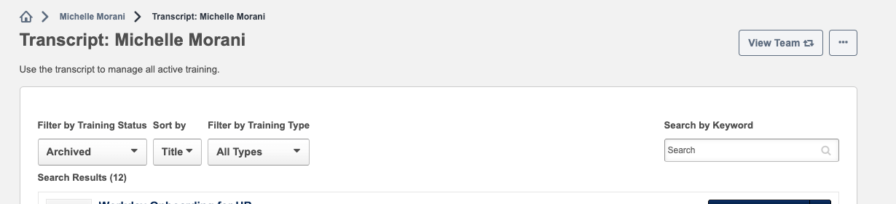
Looks like there’s two different statuses for Completed Courses? I see a Completed, but an Archived as well. Shouldn’t Archived Courses also be completed? (All of those are marked as completed for Michelle). This feels like it’s going to cause confusion for users. (10 Completions below, but 12 Archived)

Slide 4
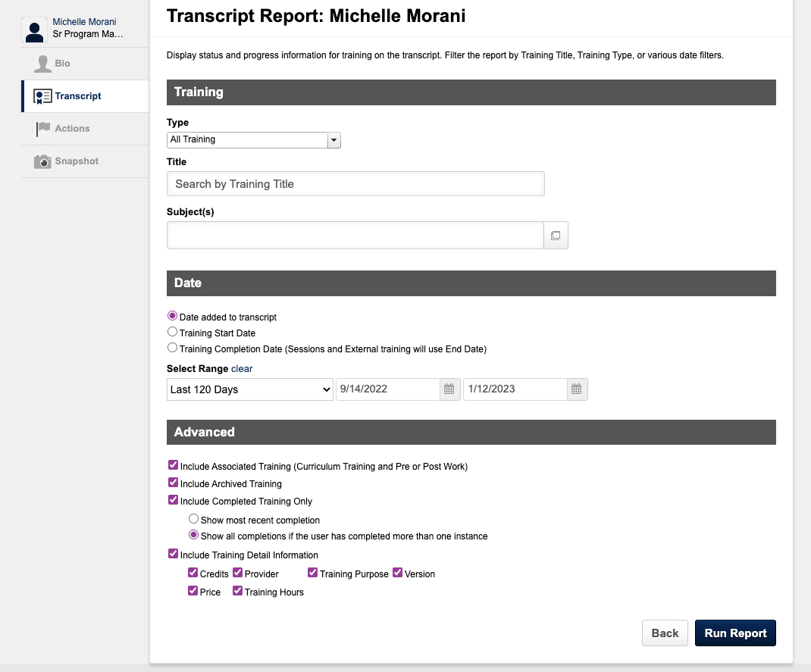
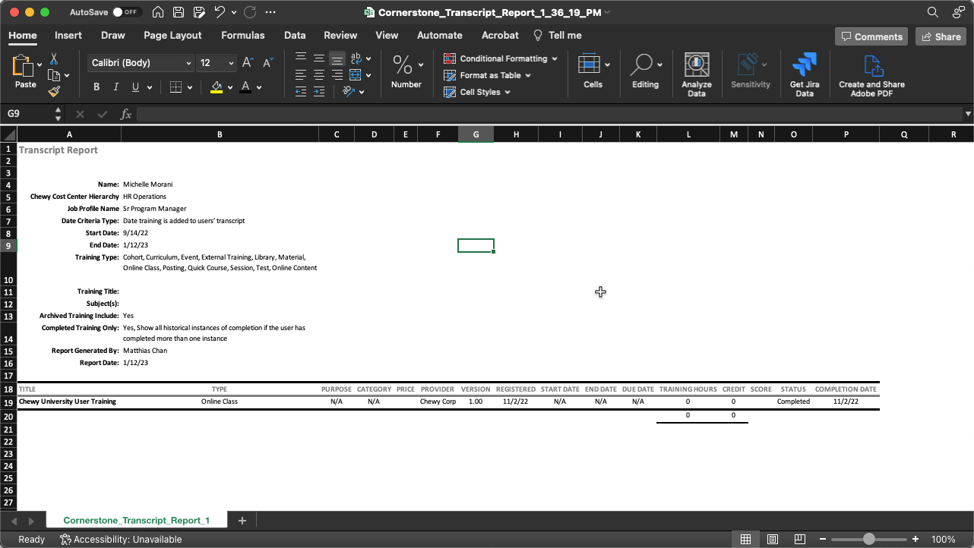
Even more confusing, if I go run a transcript report for Michelle, and use last 120 days (she’s hasn’t been here for 120, so this should return everything), I only see 1 record, no matter how I slice and dice and change filters. Is that intentional? We can absolutely help with this type of reporting, but we were operating under the impression you all were going to just have dashboards within CSOD that everyone would be using. Happy to help however we can!

